Slide 1
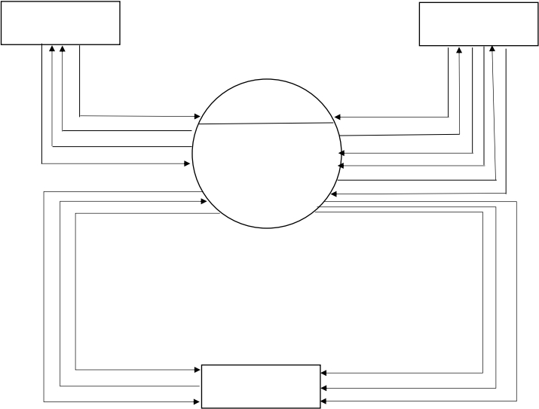
CONTEX LEVEL DIAGRAM
CODEWORK FREELENCER MANAGEMENT SYSTEM
FREELANCER
CLIENT
Request For Project
0.0
Make Inquiry
View Client Project
CODEWORK
Get Inquiry Reply
Success/Fail
Client Details
Freelancer Details
FREELANCER
Post Project
MANAGEMENT
Request For Project
SYSTEM
Accept/Denied
Client Information
ADMIN
Client Inquiry Details
Get Inquiry Reply
Client Registration Details
Freelancer Details
Client Project Details
1

Slide 2
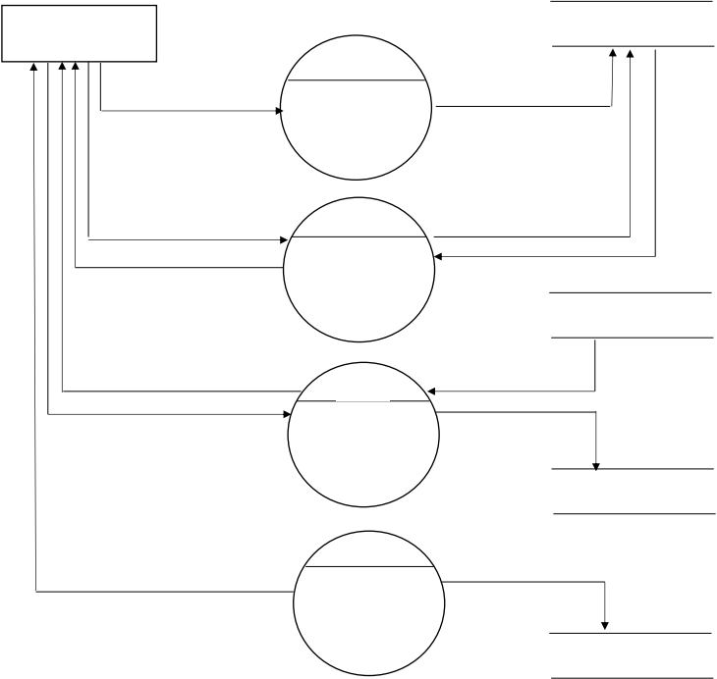
FIRST LEVEL DIAGRAM FREELANCER
CODEWORK FREELENCER MANAGEMENT SYSTEM
FREELANCER
FREELANCER
1.0
Registration Details
Registration
Registration Information
User ID & Password
2.0
Log In Information
Success & Fail
Success & Fail
Log In
POST_PRJ
View Project
3.0
Project Details
Request For Project
Project Request
View
Project
REQUEST_PRJ
4.0
Freelancer Feedback
Submitted
Feedback
FEEDBACK
2

Slide 3
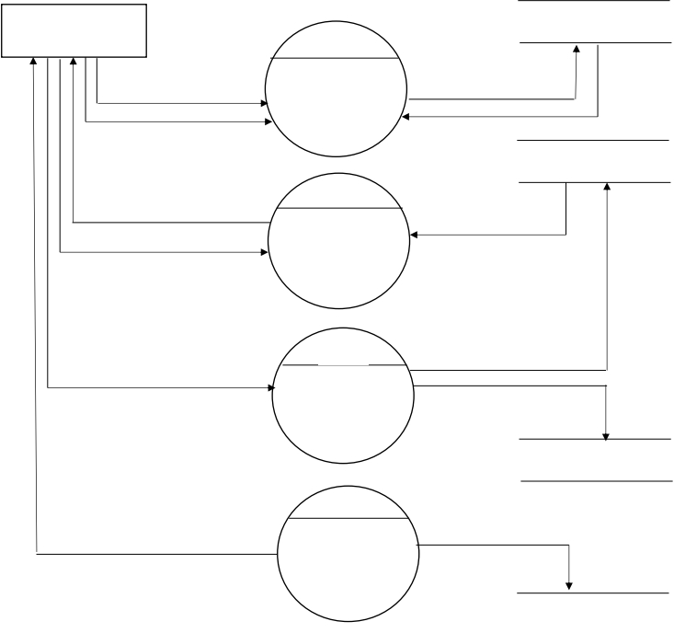
FIRST LEVEL DIAGRAM ADMIN
ADMIN
ADMIN
1.0
ID & Password
Log In
ID & Password
Success & Fail
Success & Fail
FREELANCER
2.0
Freelancer Registration
Freelancer Registration
details
Accept/Denied
Verification
Freelancer
3.0
Manage freelancer
Users Details
Manage
Manage Client
Users
CLIENT
4.0
View Feedback
Feedback
Feedback Details
FEEDBACK
3

Slide 4
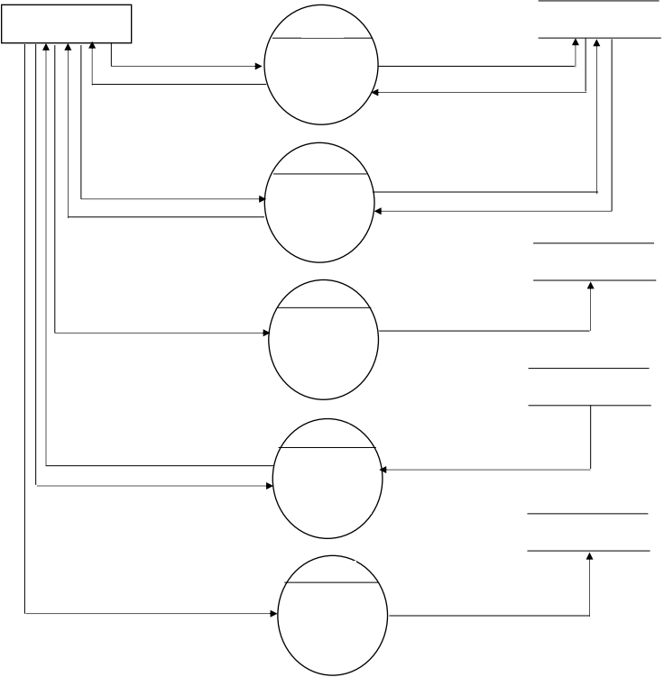
FIRST LEVEL DIAGRAM CLIENT
CODEWORK FREELENCER MANAGEMENT SYSTEM
CLIENT
1.0
CLIENT
Client Details
Registration
Client details
Success & Reject
Success & Reject
2.0
ID & password
Log In
Log In Details
Accept & Reject
Accept & Reject
POST_PRJ
3.0
Post Project
Post
Project Details
REQ_PRJ
4.0
Freelancer Request
Project
Freelanceer Request
Accept & Reject
Request
Verification
FEEDBACK
5.0
Submit Feedback
Feedback
Client Feedback
4

Slide 5
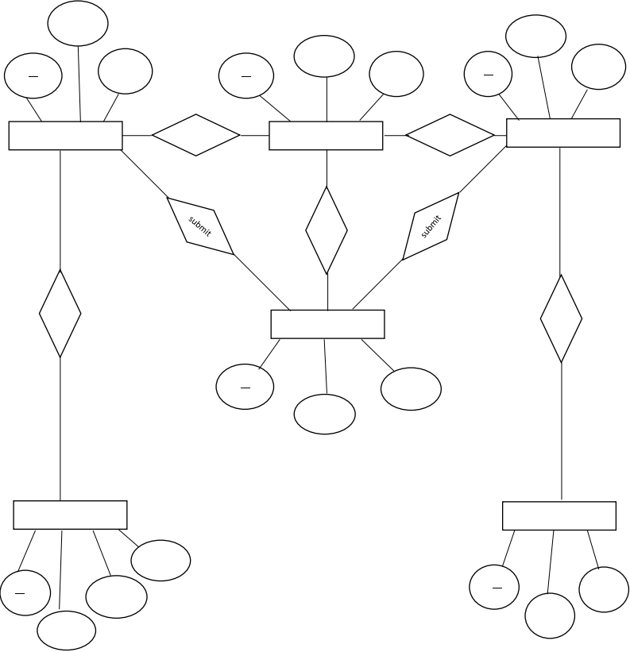
E R DIAGRAM
CODEWORK FREELANCER MANAGEMENT SYTEM
email
email
pass
email
pass
id
pass
id
id
CLIENT
M
has
1
ADMINE
1
has
M
FREELANCER
1
1
1
1
1
view
Post
M
M
M
send
FEEDBACK
id
msg
name
M
M
POST PROJECT
REQUEST PROJECT
desc
id
name
id
fid
price
pid
5

